Slide 1
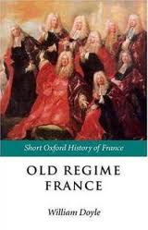
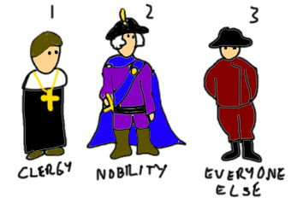
The French Revolution: Part 1
The Old Regime
• Old Regime—social and political system in France
during the 1770s
• Estates—three social classes of France’s Old
Regime
France Followed ancien regine – or old order – that had been followed in the Middle Ages
Economic and social inequalities in the
Old Regime help cause the French Revolution
The First Estate – The Clergy
The Second Estate – The Nobility
The Third Estate – Everyone Else

Slide 2
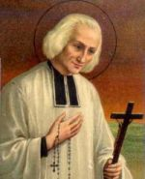
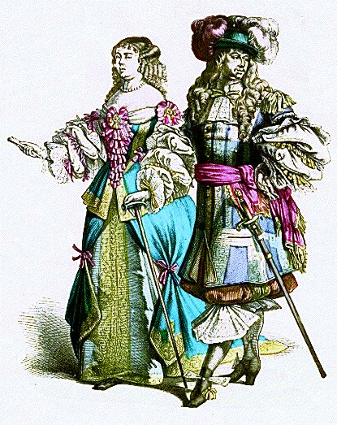
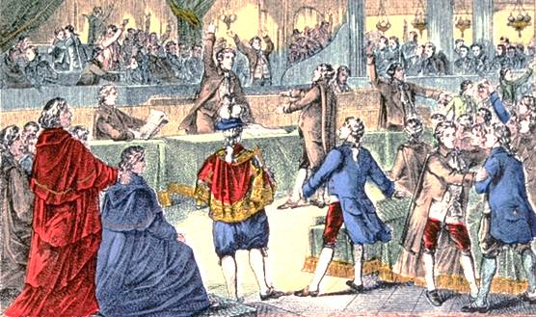
Privileged Estates
• First Estate —Catholic clergy—own 10 percent land,
pay few taxes
• Second Estate —rich nobles—2 percent population,
own 20 percent land

Slide 3
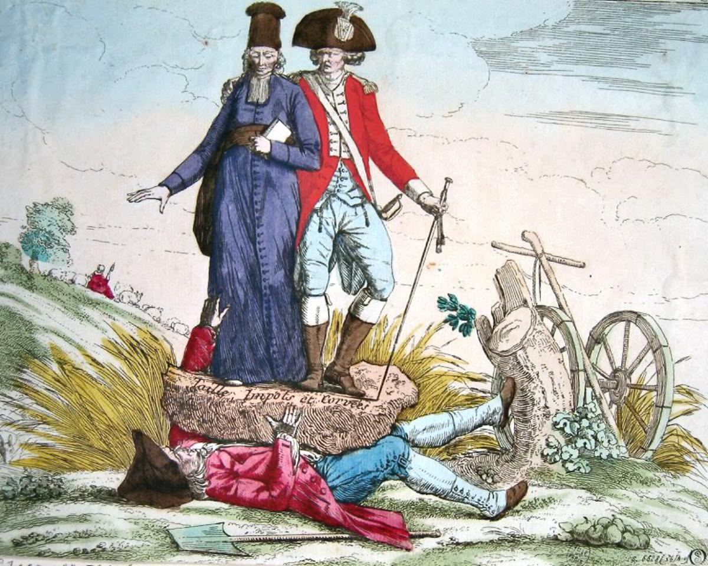
The Third Estate
• 97 percent of people
are peasants,
urban workers,
middle class
• Have few privileges,
pay heavy taxes,
want change
Third estate being crushed by high tithes and taxes put on them by the first and second estates

Slide 4
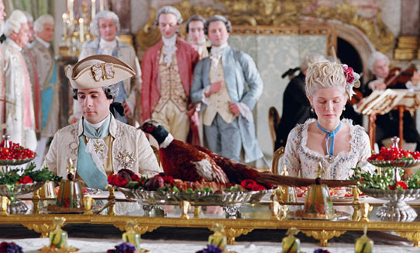
Economic Troubles
• High taxes and rising costs
damage economy by 1780s
• King Louis XVI and his wife
Marie Antoinette
known for extravagance
• France continued to borrow
money rather than pay off its existing
Loans by raising taxes.
Louis doubles nation’s debt

Slide 5
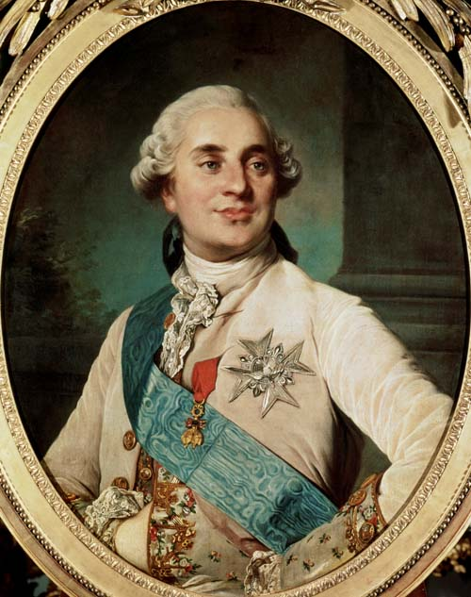
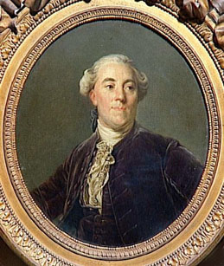
A Weak Leader
• Louis XVI was well meaning, but weak & indecisive
Louis’s poor decisions and lack of patience add to France’s problems
Jacques Necker – Louis’s financial advisor urged Louis to stop extravagant spending
When he suggested taxing the 1st and 2nd Estates Louis dismissed him
• He calls Estates-General—meeting of
representatives from all three estates

Slide 6
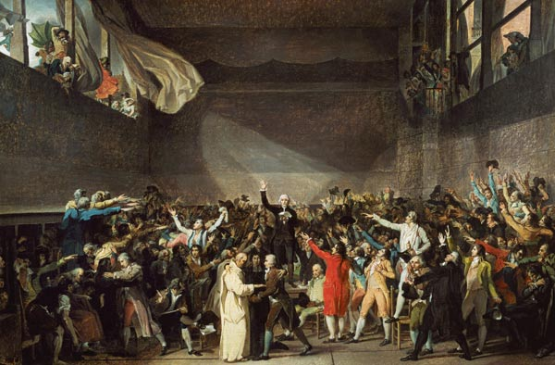
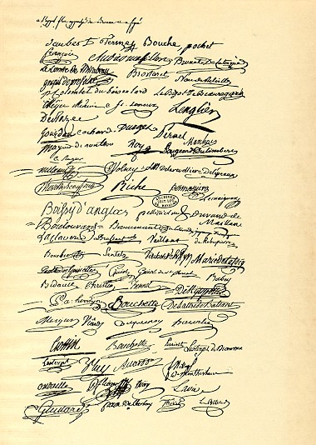
The National Assembly
• Third Estate has little power under old rules
• Delegates persuade them to make major changes in French government
• Third Estate sets up National Assembly — new
legislature to make reforms
• Oath of the Tennis Court —delegates decide to write new constitution for France

Slide 7
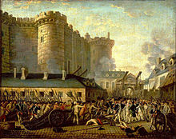
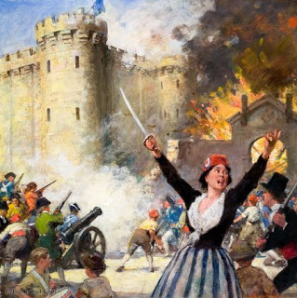
Storming the Bastille
• Rumors fly in Paris that Louis wants to suppress National Assembly
• Mob attacks and seizes Bastille, killing guards on July 14, 1789 (Bastille Day, like our 4th of July.)
Wake-up call to Louis XVI

Slide 8
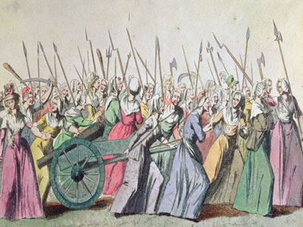
Rumors Create the “Big Fear”
Rebellion
• Rumors and panic spread throughout France
• Great Fear—attacks by peasants taking place across
France
• Peasants destroy legal papers binding them to feudal system
• In October 1789, Parisian women revolt over rising price of bread
• They demand action, forcing Louis to return from Versailles to Paris
The revolutionary government of France makes reforms but also uses terror and violence to retain power.

Slide 9
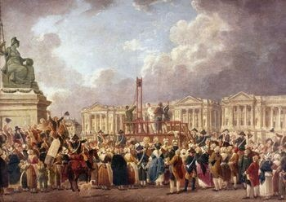
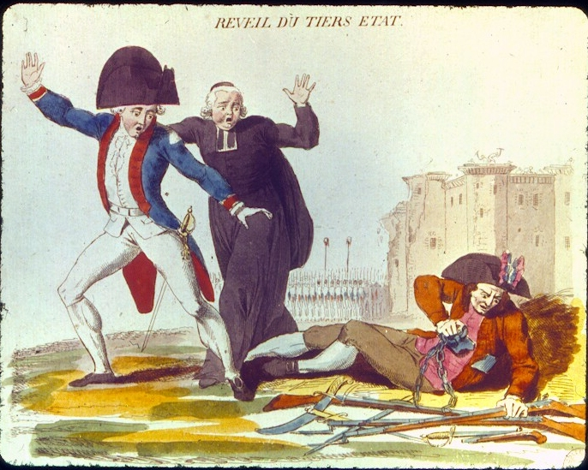
The Assembly Reforms France
• National Assembly adopts Declaration of the Rights of Man and of the Citizen
• Revolutionary leaders use the slogan, “Liberty,
Equality, Fraternity”

Slide 10
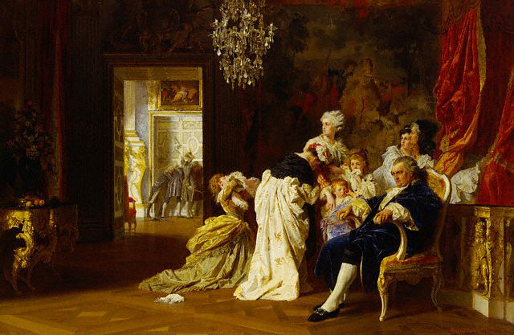
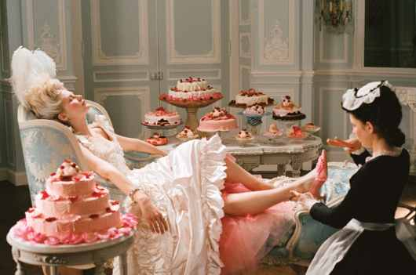
Marie Antoinette,
Queen of France – life of great pleasure & extravagance – made women of France angry
October 5 – 6,000 women march on Palace of Versailles
“Bread!” they shouted – demanded to see King & for his return to Paris
Louis , Marie & family become virtual prisoners in Paris
Painting of Louis XVI and Marie Antoinette with their Children at Versailles October 6 – being forced to return to Paris by angry mob of women
Xxxxx

Slide 11
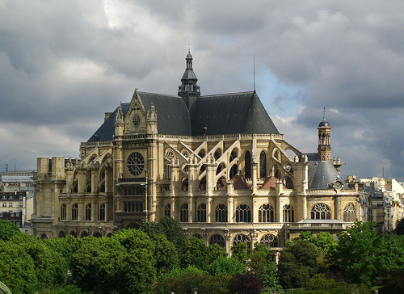
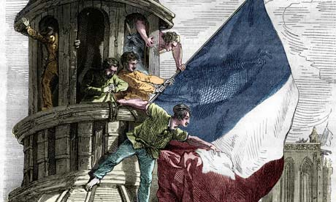
A State-Controlled Church
• National Assembly seizes church lands, turns clergy
into public officials
• This action alarms many peasants, who are devout
Catholics

Slide 12
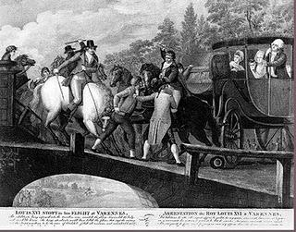
Louis Tries to Escape
• Louis, worried about his future, attempts to escape France
• Revolutionaries catch the royal family near Netherlands’ border

Slide 13
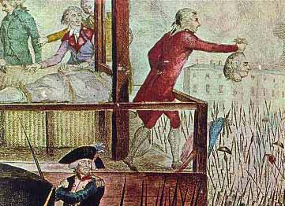
A Limited Monarchy
• In September 1791, Assembly finishes new constitution
• Legislative Assembly—new body created to pass laws
Factions Split France – Widespread Fear
• Major problems, including debt, food shortages remain
• Assembly split into Radicals, Moderates,
Conservatives
• Émigrés—nobles who flee country, want Old
Regime back in power – fear of mobs, attacks, beheadings
•

Slide 14
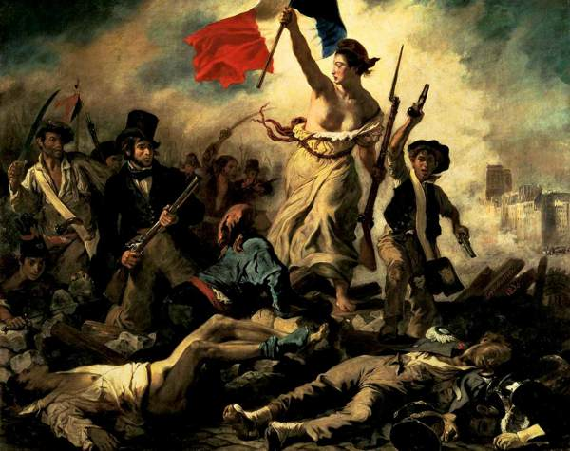
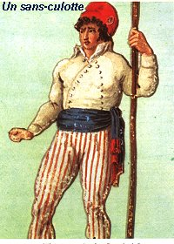
Sans-culottes— lower class who want more change
from the Revolution
Sans-culotte means “without breeches” because they wore long trousers instead of fancy knee breeches

Slide 15
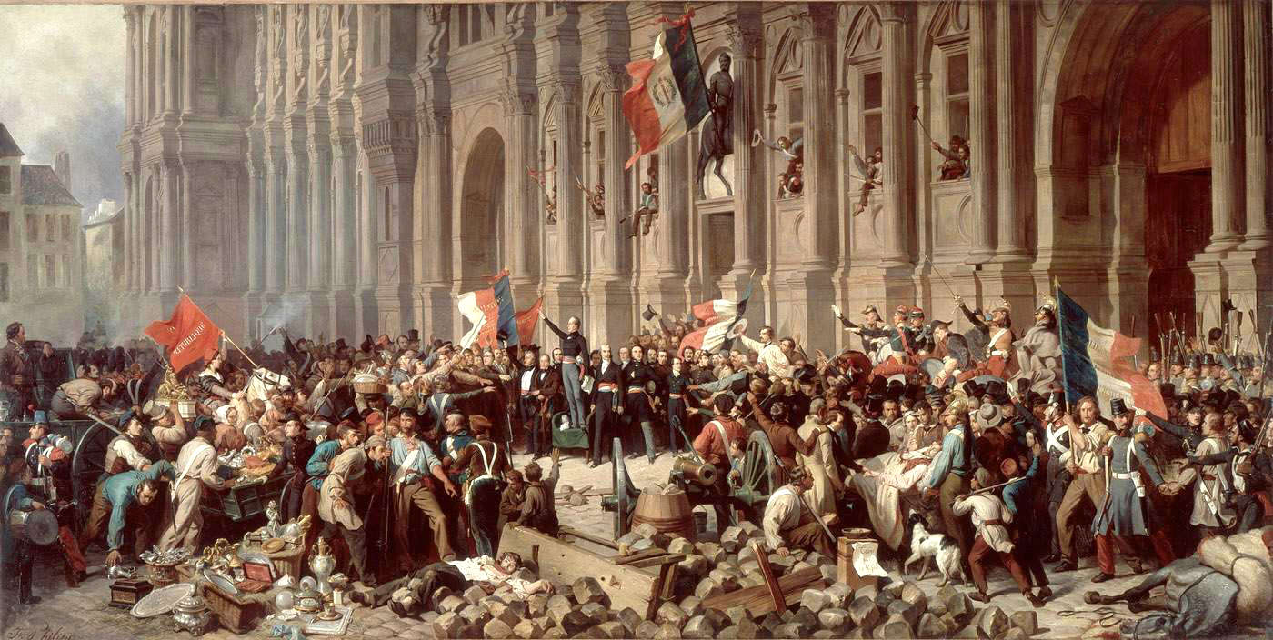
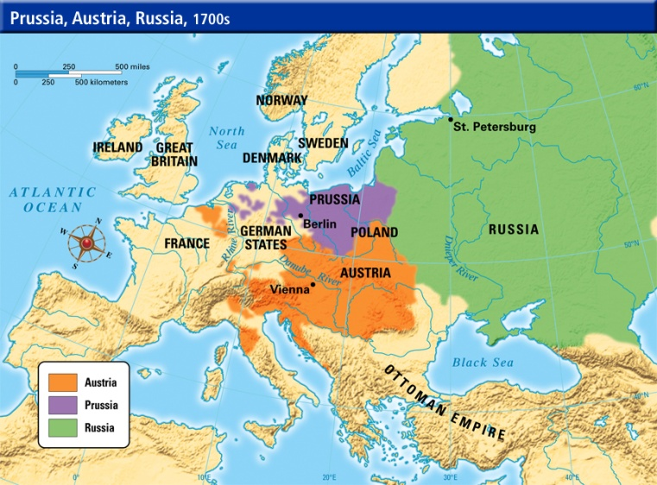
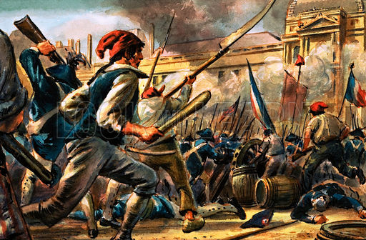
Problems with Other Countries
• Austrians and Prussians want Louis in charge of France; France declares war
France at War
• Parisian mob jails royal family, kills guards
• Mob breaks into prisons, killing over 1,000, including many who support king
• Pressured by mob, Legislative Assembly deposes the king and then dissolves
• National Convention takes office in September,
forming French Republic
X
X
X
X
X
X
X

Slide 16
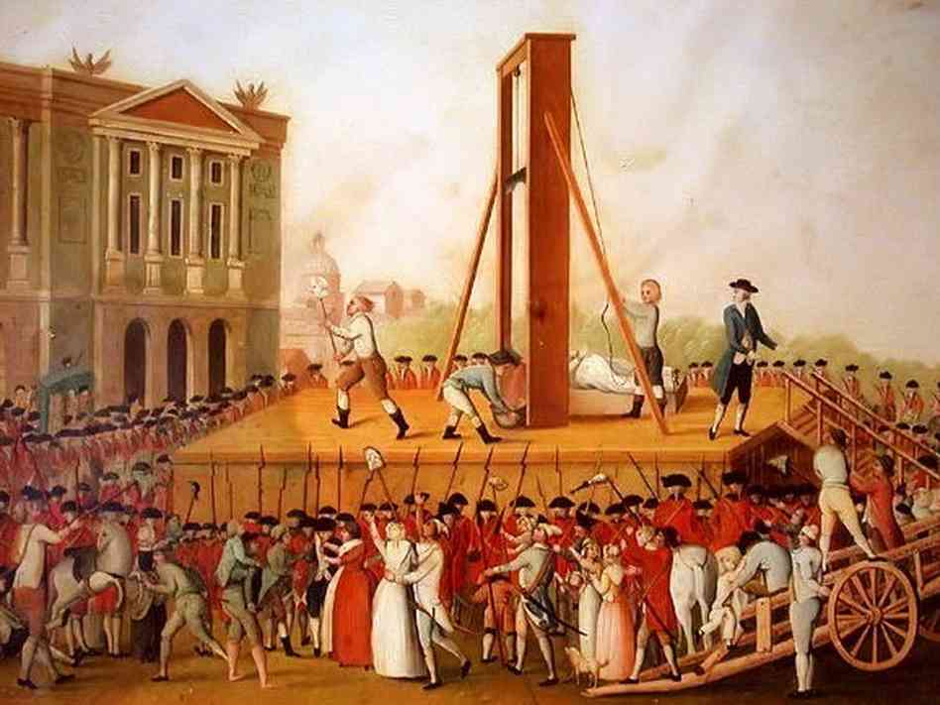
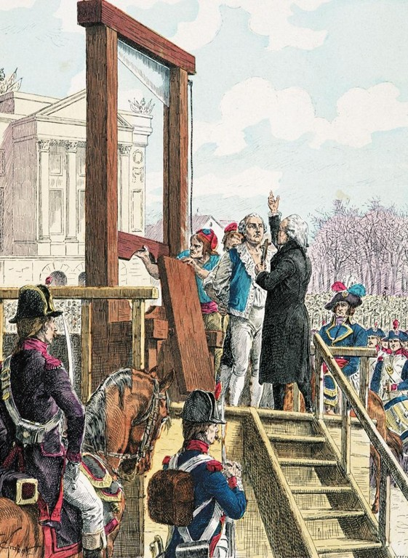
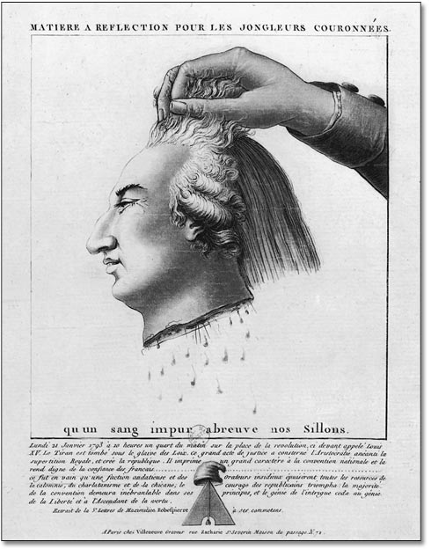
Jacobins Take Control
• Jacobins—radical political organization behind
1792 governmental changes
• After a close vote, Louis XVI is found guilty of
treason and beheaded
• Guillotine—machine designed during the
Revolution to behead people

